Slide 1
Problem Statement: Tourism Website with blockchain Technology
UEM ACE HACK
Team Pavilion
Team Members
Amit Kumar Mehta
Prince Kumar
Kushal Das
Rohit Raj

Slide 2
MARKET RESEARCH
Market Apps available for Tourism
Make My Trip
Tripit
Airbnb
Trip Adviser
Hotel To Night

Slide 3
Introduction:
In terms of the benefits blockchain technology can offer within the travel & tourism industry, stability and security rank very highly. The decentralized type of the blockchain means that data can never go 'offline' or be lost through incidental deletion or a malicious cyber attack, establish transactions are always trackable.
The travel & tourism industry trust upon different companies passing data between one another. For example, travel agents need to pass customer details on to transport companies and hotels, while the personal effects of travelers are often passed between companies and tracked too. Blockchain can make accessing and saving important data easier and more reliable because authority for storing it is shared across the overall network.

Slide 4
Blockchain comes with many unique SELLING features.
ENHANCED HIGH-END SECURITY
DECENTRALIZED BUSINESS MODEL
DATA INTEGRITY
ELIMINATION OF THIRD PARTY OR MIDDLEMAN
ENHANCED HIGH-END SECURITY
TRANSPARENCY AND STABILITY

Slide 5
TECH STACh/TECH USED
MONGO DB DATABASE SYSTEM
JAVA SCRIPT EXPRESS(express.js)
JAVA SCRIPT REACT(react.js)
JAVA SCRIPT NODE(node.js)
BLOCKCHAIN TECHNOLOGY

Slide 6
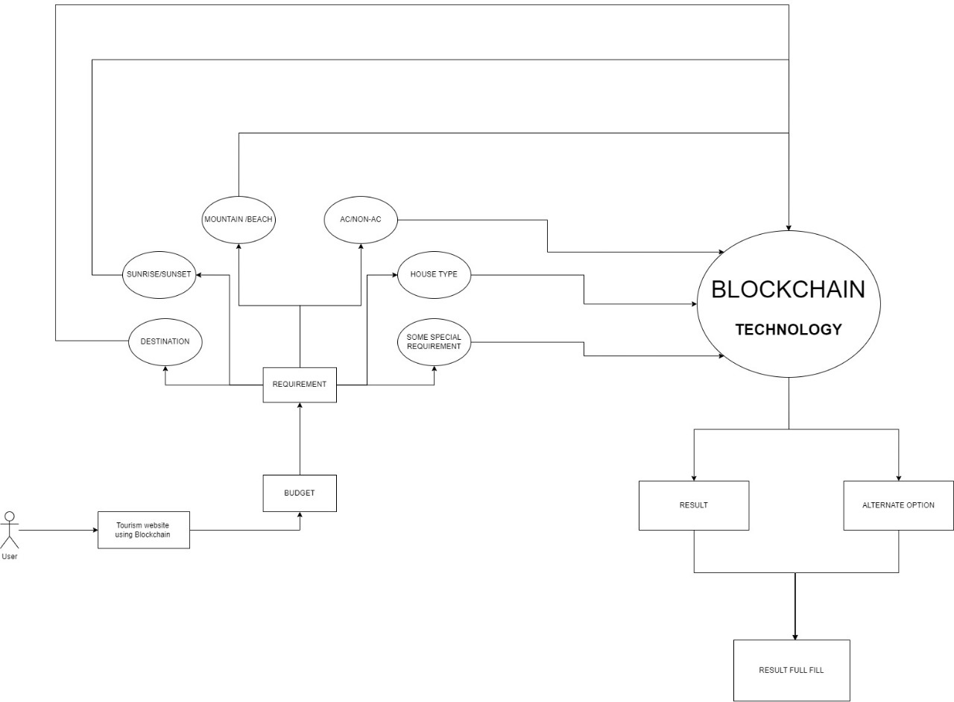
Blockchain Flow Chart

Slide 7
Sustainable in Market
GREATER CUSTOMER DATA SECURITY
FASTER PAYMENT AND GREATER SECURITY WITH TRACEABILITY FEATURES
DECENTRALIZED BUSINESS MODEL WITH TRANSPARENCY AND STABILITY
STORE ALL BACKUPS WITH TRACKING TECHNOLOGY
DECENTRALIZED DISTRIBUTION & LOWER TRANSACTION FEE FOR HOTELS

Slide 8


